Slide 1
STRATEGIC MEETING ON SUSTAINABLE PUBLIC PROCUREMENT – OPPORTUNITIES FOR ORGANIC
State of play of public procurement at the European level and IFOAM OE’s actions

Slide 2
State of play of the legislations on Public Procurement in Europe

Slide 3
Key files for Public food procurement in the EU
Directive 2014/24 on Public Procurement
Overarching law on public procurement in the EU – regulates the procurement of food and all other sectors (construction, furniture, etc).
For national authorities: to treat all applicants equally and not discriminate between them, also enforce rules in terms of transparency requirements.
MEAT (Most economically advantageous tender) criteria is part of this Directive → identified on the basis of the lowest price or the best price – quality ratio.
Quality criterion can be taken into account (may include the overall cost effectiveness, technical quality, environmental and social aspects).

Slide 4
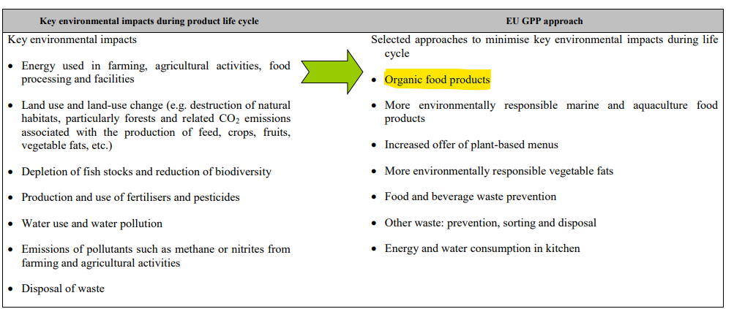
Key files for Public food procurement regulation
Green Public Procurement Guidelines (2019)
Voluntary instrument. Consists in a set of criteria that can be incorporated into a public procurement procedure to reduce the env impact of a purchase.
Organic very well positioned
First suggestion
Features both in technical specifications and award criteria
Easy to verify
Notes:
Very low uptake

Slide 5
Low uptake of GPP

Slide 6
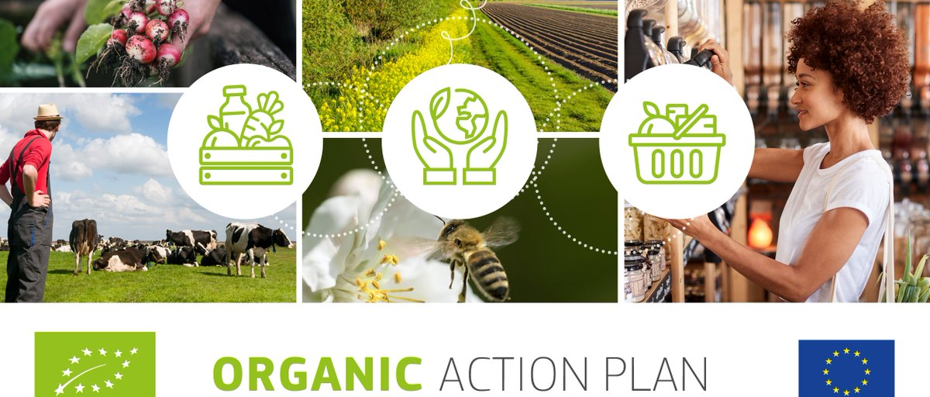
The Organic Action Plan
Analyse the situation of GPP and how to improve it
Specific events for public administrations in charge of catering
Integrating organic products into minimum mandatory criteria of the upcoming framework for sustainable food systems

Slide 7
State of play of the legislations on Public Procurement in Europe – examples of national laws for organic public procurement

Slide 8
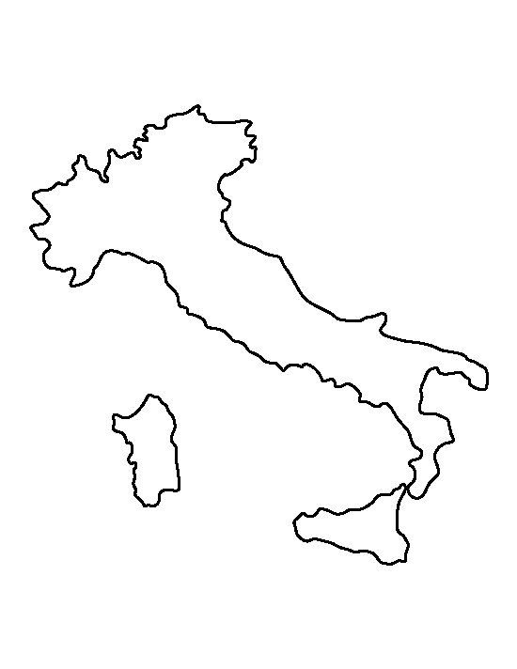
Italian Law requiring a minimum share of organic in public procurement
Dedicated associated fund established with the requirements
Differentiation of % depending on the product required in organic
Network for sustainable public procurement (technical support, communication, events, partnership, etc)
Notes:
Schools (from nurseries to high schools) have to use 100% organic: eggs, milk, yogurt, fruit juices, jams, marmalades, baby food (nurseries) Min 50% organic for fruit, vegetables, beans, grains, beef (exotic fruit may be non-organic, but Fair Trade) Min 40% : extra virgin olive oil Min 33%: peeled tomato, tomato pulp and other tomato products Min 30%: cheese, salami, ham and other cold cuts Min 20%: poultry meat Min 10%: pork (can be substituted by pork meat certified for animal welfare) At least once a year: farmed fish (if served, but it is unusual, it's used almost ever frozen sea-fish) By fair trade: chocolate tables/bars (not necessarily organic, but usually they are). In the tender, companies offering additional quantities of organic products are awarded a prize score

Slide 9
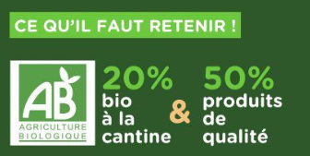
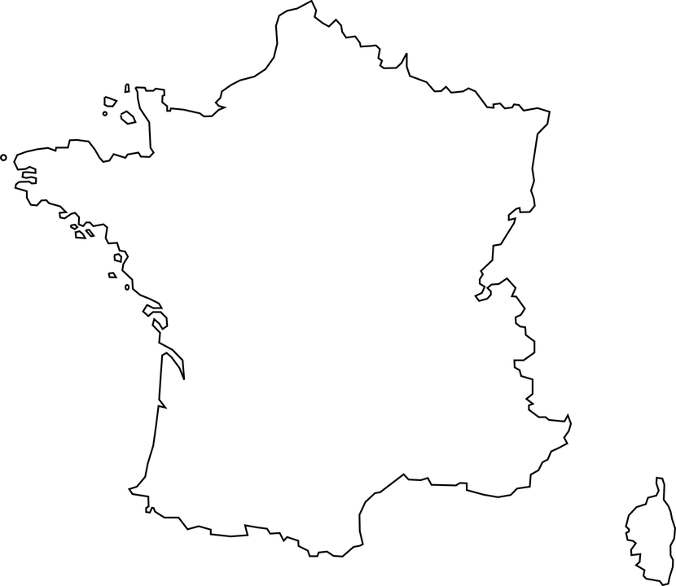
French Law for minimum share of organic in schools
20% organic in school canteens; 50% of “sustainable products”
Lack of actions on governance and market
Lack of monitoring and enforcement

Slide 10
Legislative opportunities to drive change in public procurements
Revision of the Directive 2014/24
Announced in the political guidelines of the next Commission, summer 2024
Evaluation of the public procurement Directive has started → link open: Evaluation of the Public Procurement Directives (europa.eu)
2 actions planned in the Farm to Fork Strategy
Revision of the Green Public Procurement Guidelines
Establishment of minimum mandatory requirements in the framework for sustainable food systems (SFS law)
→ Two actions very uncertain since the Farm to Fork is more and more questioned. Maybe more room for the revision of the Guidelines (because voluntary instruments → but means less impact)

Slide 11
IFOAM Organics Europe’s work on SPP

Slide 12
IFOAM Organics Europe’s work on Sustainable Public Procurement
Co-lead of the Task Force on SPP within the Food Policy Coalition
Member of the core team of the Buy Better Food Campaign
Collaboration with IFOAM Organics International and IFOAM Organics Asia on this topic

Slide 13
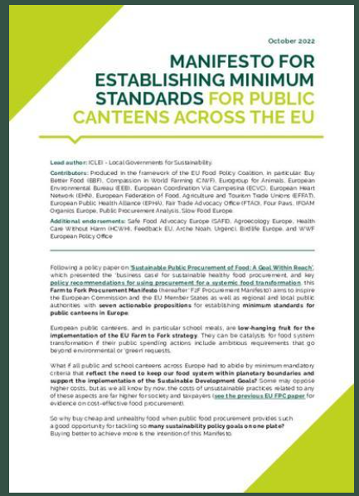
IFOAM Organics Europe’s work on Sustainable Public Procurement: Manifesto for minimum requirements with the Food Policy Coalition (IFOAM OE & ICLEI as co-leads)
Endorsed by several local and regional governments – also universities.
Very well known by the European Commission (DG SANTE and DG AGRI)
Dissemination ongoing towards DG GROW (responsible for public procurement in general) and MEPs (production of material to reach out to different political sensitivities)

Slide 14
MANIFESTO FOR ESTABLISHING MINIMUM STANDARDS FOR PUBLIC CANTEENS ACROSS THE EUC
Also disseminated by the Buy Better Food Campaign led by ICLEI
More focused on campaigning and communication activities (events and social medias)
IFOAM Organics Europe is part of the core team (designing the strategy and the next actions) but the campaign is open to national organizations at national level
Notes:
Share interesting initiatives, connect with other actors and be part of a network that can work at European but also national level

Slide 15
IFOAM Organics Europe’s work on Sustainable Public Procurement
Revision of the Directive 2014/24: opportunity for change for the public food procurement
Work with the FPC/BBF to gather expertise on the Directive and identify the potential levers and barriers (legal and technical analysis) → workshop with experts on the 30th of October
Reaching out to DG GROW (unit in the Commission responsible for PP)

Slide 16
IFOAM Organics Europe’s work on Sustainable Public Procurement
Event organized by Organic Cities and France Urbaine on the 15th of November at the European Economic & Social Committee (EESC)
→ Presentation of the campaign of France Urbaine on Public Food Procurement
Potential of pushing the topic of SPP through different topics: position of farmers in the agri-food chain (access to outlets for organic farmers, fair and stable market), the development of EU Plant-based action plan, etc.

Slide 17
Beyond Europe: work on sustainable public procurement in the IFOAM network
Strong work from IFOAM Organics Asia to work on this topic – also linked with the Global Alliance for Organic Districts (GAOD)
Publication of a book summarizing all the best practices for organic in school meals in the world
Potential for collaboration on the political level
Session in Biofach 2025 on Sustainable Public Procurement: School Food 4 Change, political developments, SPP in the world

Slide 18
THANK YOU!

