Slide 1
Main aspects of the CAP proposal, IFOAM EU advocacy work and discussion on amendment proposals IFOAM EU Farmers group meeting 14th of November 2018 Logrono, Spain Nicolas de la Vega Policy Officer, IFOAM EU

Slide 2
Content of Presentation
CAP post-2020 revisions: Short introduction on what is new
EU CAP revision process and IFOAM EU’s policy work
IFOAM EU’s position on CAP: Discussion on key amendments

Slide 3
1. CAP post-2020 revisions: Short introduction on what is new

Slide 4
Proposals for a post-2020 CAP
Scope: Revise CAP system of EU farmers support for 2021-27 period
EU CAP proposals and related documents (link):
Regulation on CAP Strategic Plans and annexes– Main CAP proposal setting objectives, definitions, structure of both pillars and allocations
Regulation on Financing, management and monitoring – Specific rules on management and control systems for Member States;
Regulation on Common Markets Organisation – Rules specific to certain sectors (e.g. cotton).
Ordinary legislative procedure (Co-decision): Council and European Parliament have equal standing, each amends proposal and then negotiate final compromise.

Slide 5
Comparing current green architecture and proposal

Slide 6
Proposed CAP Common objectives (top) and process to set National CAP Strategic Plans (below):

Slide 7
Key features of reform related to organic farming
Pillar I - New payment schemes (voluntary for famers):
Schemes for the climate and the environment or “Eco-Schemes”: rewards farmers that go beyond CAP’s minimum environmental requirements (organic farming is eligible); under Pillar I and 100% EU financed; voluntary for farmers and mandatory for Member States, but no ringfenced budget.
Complementary redistributive income support for sustainability (small farms): Annual direct payments reduced after € 60.000, capped at 100.000 (with by exemptions); money used to top up small farms;
Complementary income support for young farmers: Countries to dedicate minimum 2% of direct payments to young farmers objective, support decoupled; young famers must be under 40 years;
Coupled payments for specific sectors allowed with maximum 10%.
Pillar II - Rural development: restructured under new result-oriented architecture, no longer lists agri. practices/systems (e.g. “measure 11” for OF):
Conversion and maintenance for for organic farming eligible under “environment and climate commitments” with minimum 30% of Pillar 2 budget (without areas of natural constraint).
Risk management tools (insurance): farm income risk; mandatory for MS; financed by RD

Slide 8
2. CAP revision process and IFOAM EU policy work

Slide 9
Timeline IFOAM EU activities on CAP
IFOAM EU Activity | Date
IFOAM EU Vision for public goods & letter to EU Institutions | Jan 2017
Seminar with Permanent Representations | May 2017
Response to CAP public consultation | May 2017
Open Letter to COM in response leaked Communication | November 2017
Open Letter to Council President on post-2020 MFF (budget) | February 2018
FiBL Report on new CAP payment model (before CAP proposal) | April 2018
European Parliament “Dorfmann” INI Report: meetings and AMs | March-May 2018
12EOC CAP high-level panel and workshop | September
IFOAM EU CAP position | Early October 2018
European Parliament event on CAP | 10 October 2018
Meeting MEPs and Council on amendment recommendations | October 2018 - early 2019
IFOAM study on CAP with FiBL and IEEP, including 2 expert workshops | September 2018 - May 2019
Biofach CAP session | 13-15 February 2019
Collaboration with NGOs and other stakeholders | Ongoing

Slide 10
Timeline of milestones for CAP revision
Political Milestone | Date
Commission Public Consultation on CAP | Feb-May 2017
Commission Communication on CAP | 29 Nov 2017
AGRI Council: Presidency Conclusions on CAP | 19 March 2018
European Parliament Own-Initiative ‘Dorfmann’ Report | 30 May 2018
CAP legislative proposal launched by Commission | 01 June 2018
European Parliament (EP) assigned Rapporteur and Shadows | July 2018
EP Draft report presented in ENVI and AGRI Committees | November 2018
EP Deadline for CAP amendments in AGRI and ENVI Committees | 3 November; 13 of November
EP CAP votes in AGRI and ENVI | Both 2nd half February 2019 (TBC)
EP plenary vote of CAP | March/April 2019 (TBC)
Each country prepares its CAP Strategic Plan, European Commission to approve them | Next 2 years up to late 2020
New CAP in place from | January 2021 (TBC)

Slide 11
CAP Dossier in European Parliament
Parliament Committees involved:
AGRI - Lead committee
ENVI - Shared Competence with AGRI on key articles (objectives, indicators, eco-schemes, agri-env., ringfence)
Opinions by: DEVE, BUDG, REGI, FEMM
Provisional timeline (subject to May 2019 elections):
AGRI’s draft report to be published Mid-November (available ES)
Amendments’ deadline 3 December 2018
Votes in Committee 2nd half of February 2019
Vote in Plenary Mach-April 2019

Slide 12
IFOAM EU Advocacy activities
European Commission: in contact via events, meetings and CDGs (IFOAM EU elected chair of CAP CDP on 07/11)
European Parliament:
Propose amendments to MEPs & groups, meet offices of most AGRI and ENVI lead MEPs in October 2018 to April 2019
Keep eye on political level: delays likely with election
IFOAM members encouraged to meet MEPs & present amendments (contact nicolas.delavega@ifoam-eu.org for latest CAP amendment list)
Council:
Meetings with Country representations in Brussels
Advocacy by IFOAM EU members at national level, both on the legislative revision and on the preparation of National Plans

Slide 13
IFOAM EU report – Work with FiBL and IEEP
Title: Proposal for Policy Recommendations and Guide to maximise public goods delivery through post-2020 national CAP Strategic Plans
Duration: October 2018 – May 2019
Aim: optimise use of Eco-schemes and link it to the rest of green architecture; offer realistic template that could help Member States draft their national CAP Strategic Plans
Build upon previous IFOAM EU report with FiBL on payment models.
Organise 2 workshops with national experts, gather info and test ideas:
FOAM EU members encouraged to join and propose national experts that could participate
Expected dates: the 1st in February and the 2nd in May of 2019

Slide 14
3. IFOAM EU’s position on CAP: Discussion on key amendments

Slide 15
IFOAM EU CAP position papers
IFOAM EU position paper January 2017 on long term vision:
"A CAP for healthy farms, healthy people, healthy planet – Public money must deliver public goods"
IFOAM EU new position paper on revision process (prepared in FG and Council of IFOAM EU):
“Towards a post-2020 CAP that supports farmers and delivers public goods to Europeans: Avoiding a race to the bottom - An ambitious and better targeted CAP”

Slide 16
CAP Amendments - Objectives
Text from European Commission Proposal | Proposed amendments
Article 6.1 – Specific Objectives The achievement of the general objectives shall be pursued through the following specific objectives: […] (e) foster sustainable development and efficient management of natural resources such as water, soil and air; […] (i) improve the response of EU agriculture to societal demands on food and health, including safe, nutritious and sustainable food, food waste, as well as animal welfare. | Article 6.1 – Specific Objectives The achievement of the general objectives shall be pursued through the following specific objectives: […] (e) foster sustainable development and efficient management of natural resources such as water, soil and air, giving priority to integrated farming system as the enhanced management of permanent pastures, landscape features, and organic farming.; […] (i) improve the response of EU agriculture to societal demands on food and health, including organic farming, safe, nutritious and sustainable food, food waste, as well as animal welfare.

Slide 17
CAP Amendments - Eco-schemes 1/2
Text from European Commission Proposal | Proposed amendments
Article 28.3 – Eco-schemes Member States shall establish the list of agricultural practices beneficial for the climate and the environment. | Article 28.3 – Eco-schemes Member States shall establish the list of agricultural practices and systems beneficial for the climate and the environment. When drafting their CAP Strategic Plans Member States should prioritise integrated farming systems which deliver multiple benefits in a cost-effective way for the achievement of objectives (d), (e), (f) and (i) of Article 6.1, such as the enhanced management of permanent pastures, landscape features, and organic farming.
Article 28.4 – Eco-schemes Those practices shall be designed to meet one or more of the specific environmental and climate-related objectives laid down in points (d), (e) and (f) of Article 6(1). | Article 28.4 – Eco-schemes Those practices shall be designed to meet one or more of the specific environmental and climate-related objectives laid down in points (d), (e) and (f), and the socio-economic objective in point (i) of Article 6(1).

Slide 18
CAP Amendments - Eco-schemes 2/2
Text from European Commission Proposal | Proposed amendments
Article 28.4 – Eco-schemes | Article 28.4 NEW – Eco-schemes Eco-schemes should be tailored to address specific regional needs for the environment and climate that can be identified in the CAP Strategic Plans.
Article 15.2 bis - Reduction of payments | Article 15.2 bis Reduction of payments The schemes for the climate and the environment shall not be considered as direct payments under this specific article concerning reduction of payments.
Recital 40 […] Member States should also ensure that payments to farmers do not lead to double funding with eco schemes. Furthermore, the specific needs of Natura 2000 areas should be taken into account by Member States in the overall design of their CAP Strategic Plans. | Recital 40 […] Member States should also ensure that payments to farmers do not lead to double funding with eco schemes, while at the same allowing enough flexibility in Strategic Plans to facilitate complementarity between different interventions. Furthermore, the specific needs of Natura 2000 areas should be taken into account by Member States in the overall design of their CAP Strategic Plans.

Slide 19
CAP Amendments – Budget for climate and environment
Text from European Commission Proposal | Proposed amendments
ALTERNATIVE: 86.2 - Minimum and maximum financial allocations At least 30% of the total EAFRD contribution to the CAP Strategic Plan as set out in Annex IX shall be reserved for interventions addressing the specific environmental- and climate-related objectives set out in points (d), (e) and (f) of Article 6(1) of this Regulation, excluding interventions based on Article 66. The first subparagraph does not apply to the outermost regions. | ALTERNATIVE: 86.2 - Minimum and maximum financial allocations At least 30% of the total EAFRD contribution to the CAP Strategic Plan as set out in Annex IX shall be reserved for interventions addressing the specific environmental- and climate-related objectives set out in points (d), (e) and (f) of Article 6(1) of this Regulation, excluding interventions based on Article 66. Without prejudice to previous paragraph, at least 70% of the total sum of CAP Strategic Plan contributions from the EAFRD and direct payments in EAGF as set out in annexes VII and IX shall be reserved for interventions addressing the specific environmental and climate-related objectives set out in points (d), (e) and (f), and societal demands objective (i) of Article 6(1) of this Regulation, excluding interventions based on Article 66. Member States may choose the proportion of EAFRD and direct payments going to the mentioned objectives, provided that the total sum amounts to 70%.

Slide 20
CAP Amendments – Budget for organic
Text from European Commission Proposal | Proposed amendments
86.2 – Ringfencing for organic farming | 86.2 NEW – Ringfencing for organic farming At least 10/xx % of the combined EAGF and EAFRD contribution to the CAP Strategic Plan shall be reserved to support the conversion and maintenance of organic land under articles 28 and 65 of this Regulation. Member States shall keep the rates of payments towards organic conversion and maintenance in line with the growth of the sector and the demand of consumers. The yearly budget of organic conversion and maintenance payments in a CAP Strategic Plan shall at no time go below the Member State’s payments granted before the year 2021.
Explanation: Demand for organic products is growing among consumers, the percentage of farmland for organic agriculture in Europe was 6,7% in 2016 and it is steadily growing at an annual rate of 6-7%. At the same time, the budget allocated for organic measures in several EU countries under the current CAP has already run out or is expected to run out before the end of the programming in December 2020. In order to maintain the confidence of the sector, it is necessary to adjust a specific minimum budget for organic farming that considers future growth. Moreover, this will help Member States to achieve a significant part of their environmental and societal objectives.

Slide 21
CAP Amendments – No backsliding to include organic
Text from European Commission Proposal | Proposed amendments
Article 92 - Increased ambition with regard to environmental- and climate-related objective 1. Member States shall aim to make, through their CAP Strategic Plans and in particular through the elements of the intervention strategy referred to in point (a) of Article 97(2), a greater overall contribution to the achievement of the specific environmental- and climate-related objectives set out in points (d), (e) and (f) of Article 6(1) in comparison to the overall contribution made to the achievement of the objective laid down in point (b) of the first subparagraph of Article 110(2) of Regulation (EU) No 1306/2013 through support under the EAGF and the EAFRD in the period 2014 to 2020. | Article 92 - Increased ambition with regard to environmental- and climate-related objective 1. Member States shall aim to make, through their CAP Strategic Plans and in particular through the elements of the intervention strategy referred to in point (a) of Article 97(2), a greater overall contribution to the achievement of the specific environmental- and climate-related objectives set out in points (d), (e) and (f) of Article 6(1) in comparison to the overall contribution made to the achievement of the objective laid down in point (b) of the first subparagraph of Article 110(2) of Regulation (EU) No 1306/2013 through support under the EAGF and the EAFRD in the period 2014 to 2020. Payments towards organic conversion and maintenance in CAP Strategic Plans under articles 28 and 65 of this Regulation shall exceed the total payments made before 2021 under Rural Development to organic farmers, calculated as a yearly average using constant prices.

Slide 22
CAP Amendments – Specific recital on Organic
Text from European Commission Proposal | Proposed amendments
Recital 30 – Organic Agriculture | Recital 30 – NEW Organic Agriculture Organic farming is developing in many European countries and has a proven track record of delivering public goods, preserving ecosystems services and natural resources, reducing inputs, attracting young farmers and women in particular, creating jobs, experimenting new business models, meeting societal demands, and revitalising rural areas. Yet the growth in the demand for organic products continues to outpace the growth in production. Member States should ensure that their CAP Strategic Plans include objectives to increase the share of agricultural land under organic management in order to meet the increasing demand for organic products, and to develop the whole organic supply chain. Member States may fund organic conversion and maintenance either through rural development measures or through eco-schemes, or through a combination of both, and should ensure that allocated budgets match the expected growth in organic production.

Slide 23
CAP Amendments – RD also to be used as incentive
Text from European Commission Proposal | Proposed amendments
Article 65.6 - Environmental, climate and other management commitments Member States shall compensate beneficiaries for costs incurred and income foregone resulting from the commitments made. Where necessary, they may also cover transaction costs. In duly justified cases, Member States may grant support as a flat-rate or as a one- off payment per unit. Payments shall be granted annually. | Article 65.6 - Environmental, climate and other management commitments Member States shall compensate beneficiaries for costs incurred and income foregone resulting from the commitments made or payments shall be made to reward beneficiaries based on the value of their contribution to the objectives (d), (e), (f) and (i) of Article 6.1. Where necessary, they may also cover transaction costs. In duly justified cases, Member States may grant support as a flat-rate or as a one- off payment per unit. Payments shall be granted annually.
Explanation: This recommendation allows for the possibility to provide a reward to farmers without links to production via the agri-environment-climate commitments in Pillar 2. This is necessary to move away from the logic of compensating farmers for the “costs incurred and income foregone” linked to a particular practice, to instead rewarding them based on the value that such agricultural practice brings in terms of public goods. This additional incentive is essential to encourage more farmers to adopt more sustainable farming practices and systems in line with the environmental and climate objectives. Moreover, this change is needed to streamline agri-environment-climate payments with the newly proposed eco-schemes, thereby increasing their complementarity.

Slide 24
CAP Amendments – Risk management to be limited
Text from European Commission Proposal | Proposed amendments
70 – Risk Management 1. Member States shall grant support for risk management tools under the conditions set out in this Article and as further specified in their CAP Strategic Plans. 2. Member States shall grant support under this type of interventions in order to promote risk management tools, which help genuine farmers manage production and income risks related to their agricultural activity which are outside their control and which contribute to achieving the specific objectives set out in Article 6. 3. Member States may grant in particular the following support: financial contributions to premiums for insurance schemes; (b) financial contributions to mutual funds, including the administrative cost of setting up; | 70.1 – Risk Management 1. Member States may grant support for risk management tools under the conditions set out in this Article and as further specified in their CAP Strategic Plans. Where a Member States chooses to support risk management, this shall be done in a way that it does not distort the market nor shall it encourage a farmer to take more risks. 2. Member States may grant support under this type of interventions in order to promote risk management tools, which help genuine farmers manage production and income risks related to their agricultural activity which are outside their control and which contribute to achieving the specific objectives set out in Article 6. 3. Member States may grant in particular the following support: (a) financial contributions to premiums for insurance schemes after justifying in their Strategic Plans that other measures including mutual funds are not sufficient; (b) financial contributions to mutual funds, including the administrative cost of setting up;

Slide 25
Still developing amendments
Working within IFOAM EU and cooperating with partners to develop:
Indicators (annex I) and their role in the result-based model
Governance structure for Member States on common rules, evaluation, incentives and penalties
Other areas of priority? Which ones?

Slide 26
Thank you
Nicolas de la Vega
Policy officer
IFOAM EU
nicolas.delavega@ifoam-eu.org
www.ifoam-eu.org

Slide 27
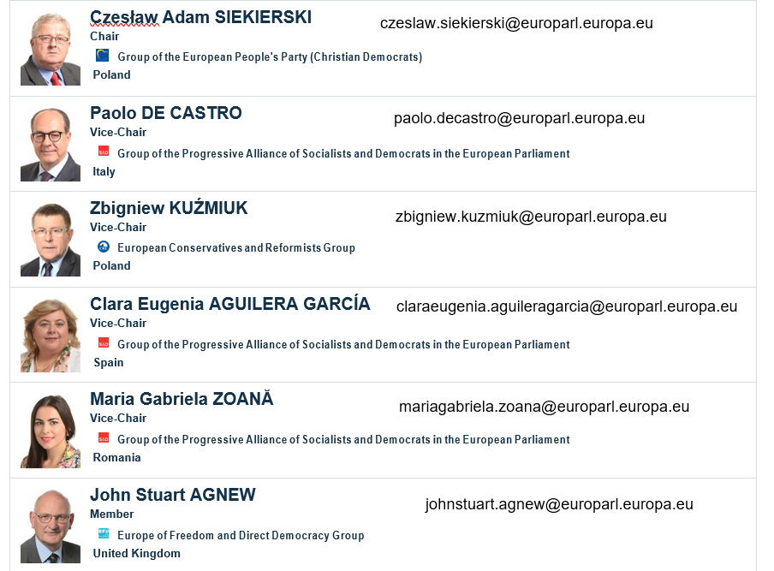
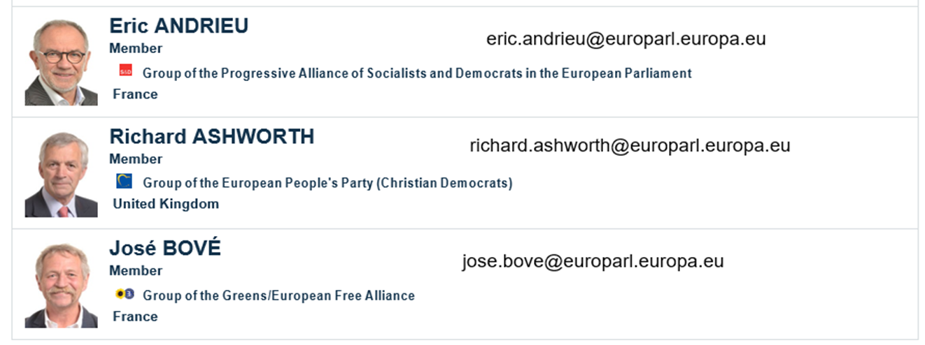
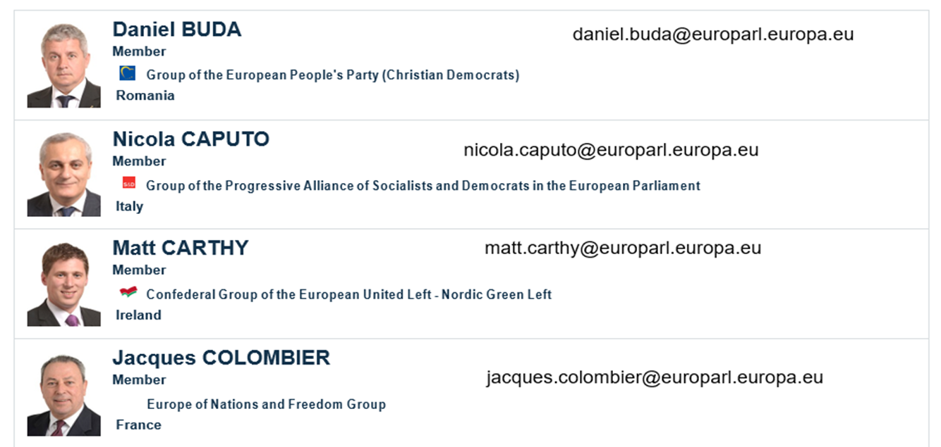
AGRI Committee

Slide 28
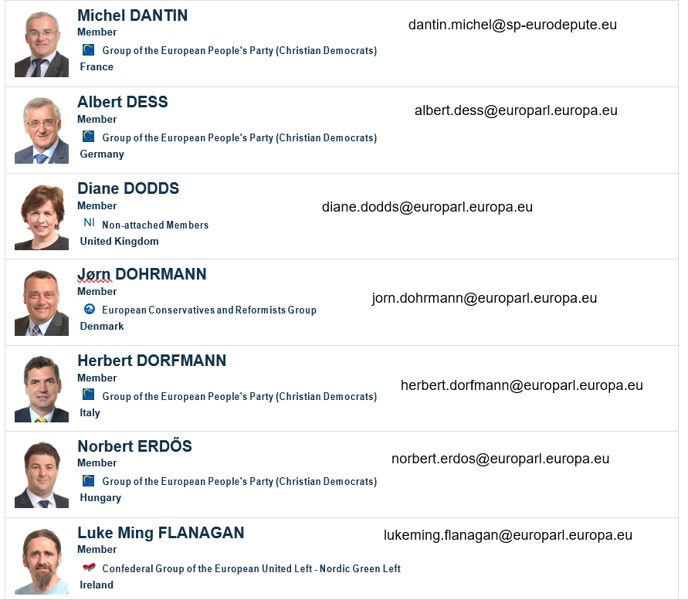
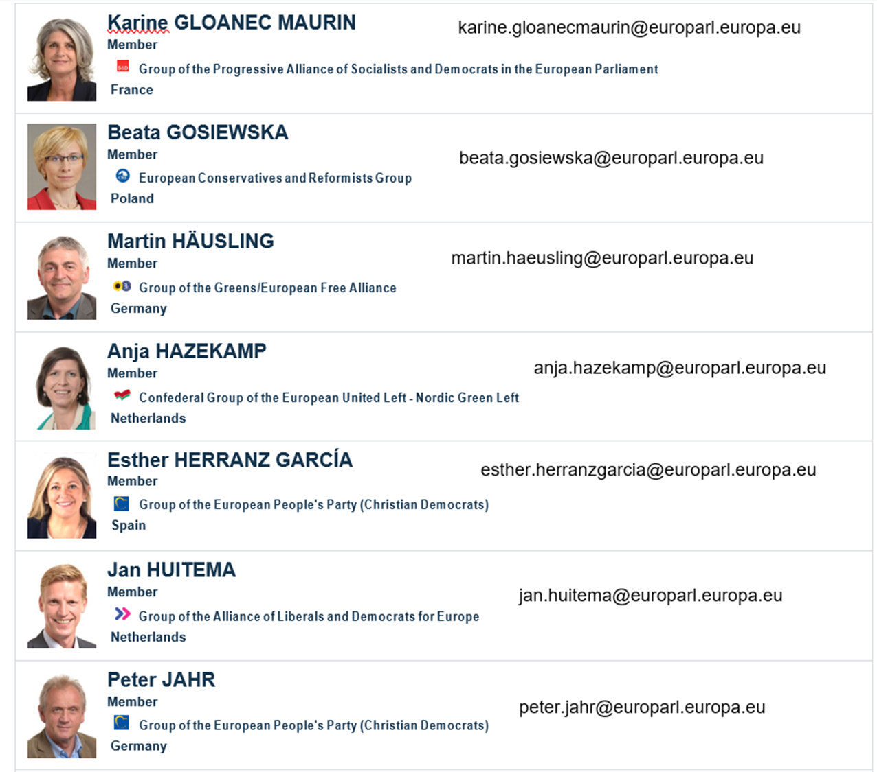

Slide 29
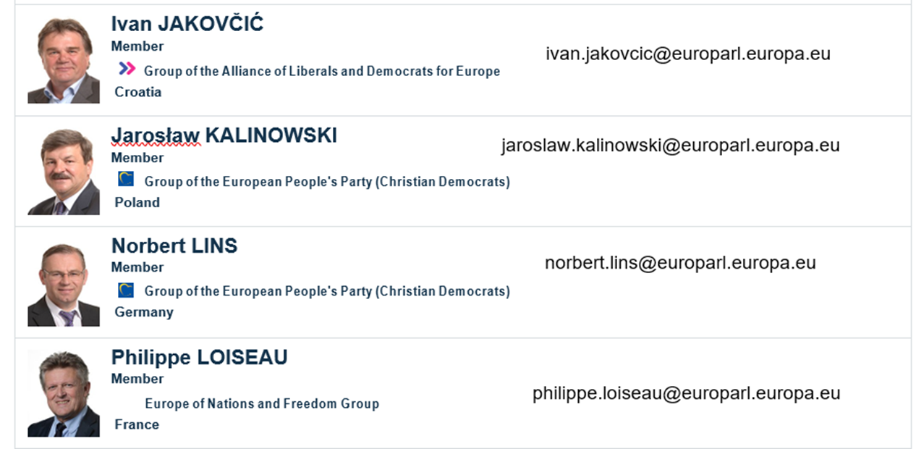
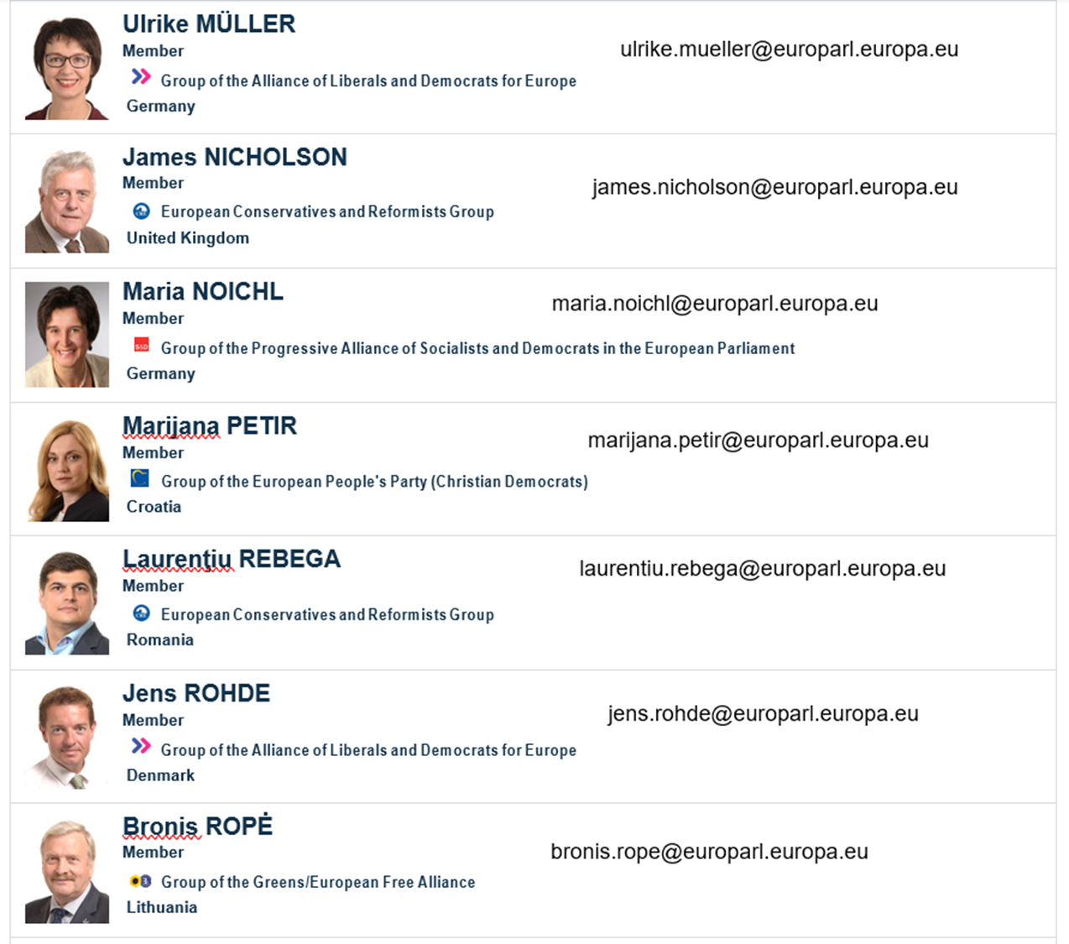
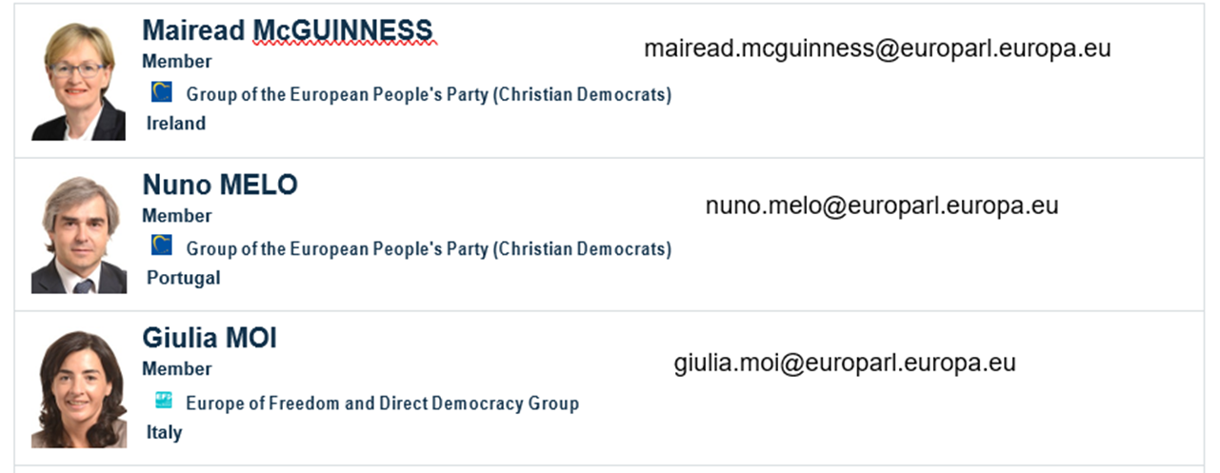

Slide 30
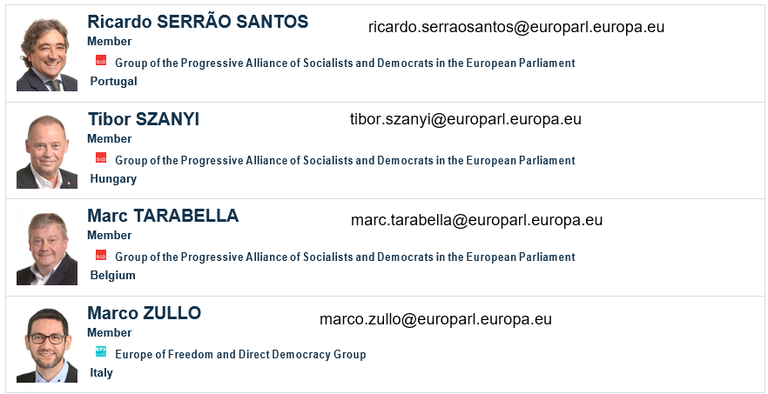

Slide 31
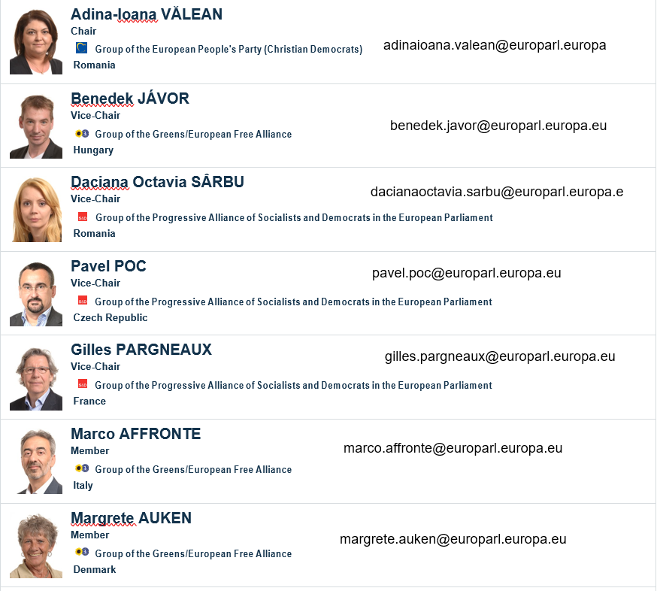
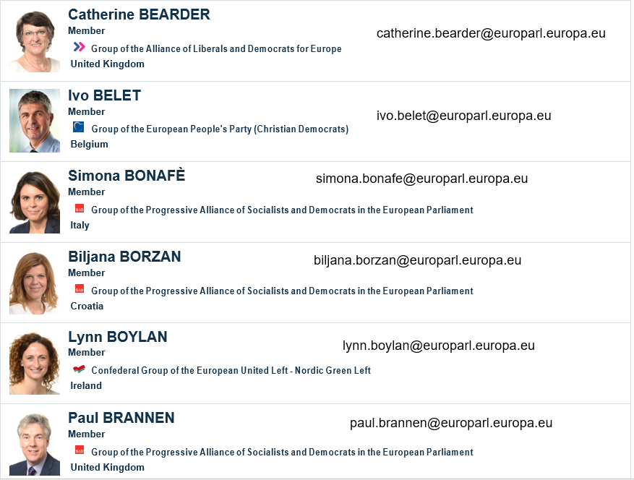
ENVI Committee

Slide 32
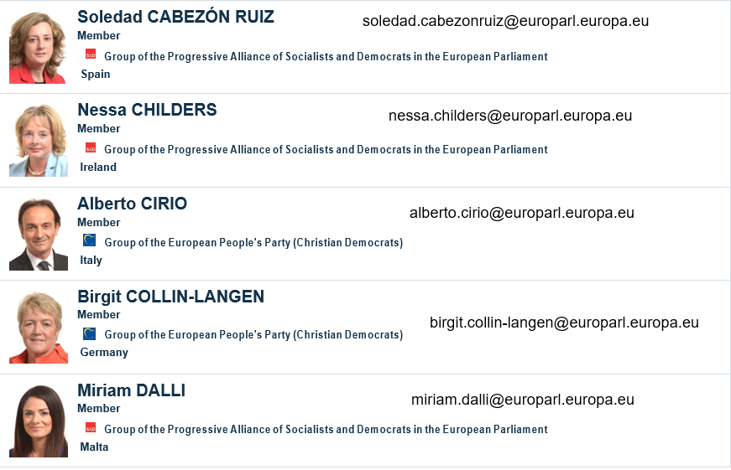
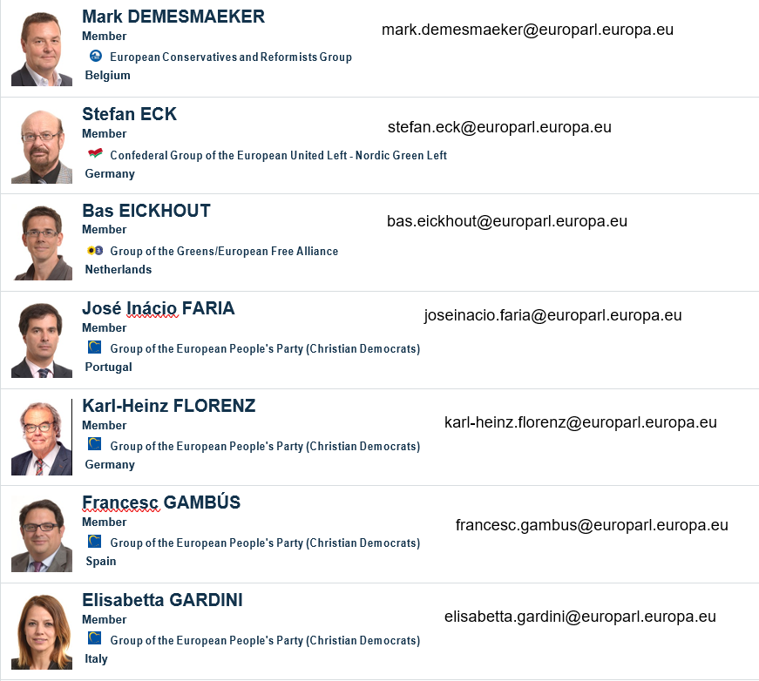

Slide 33
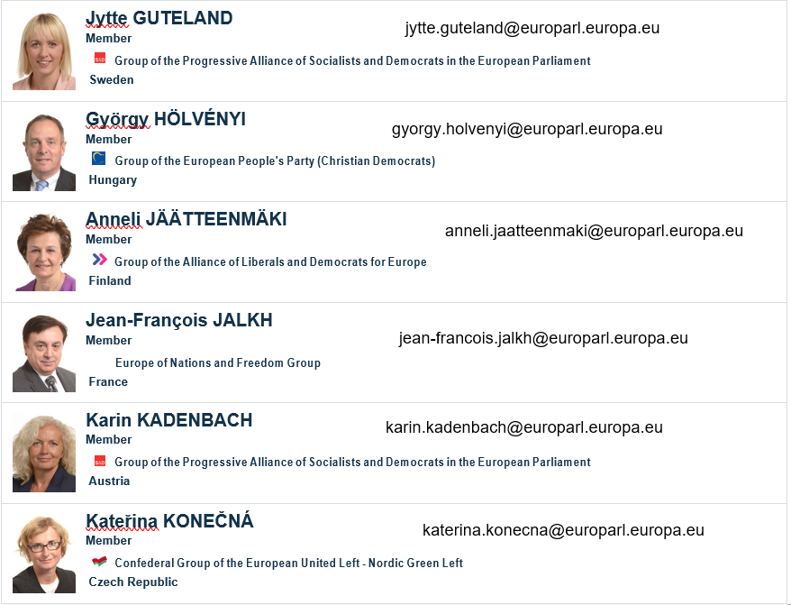
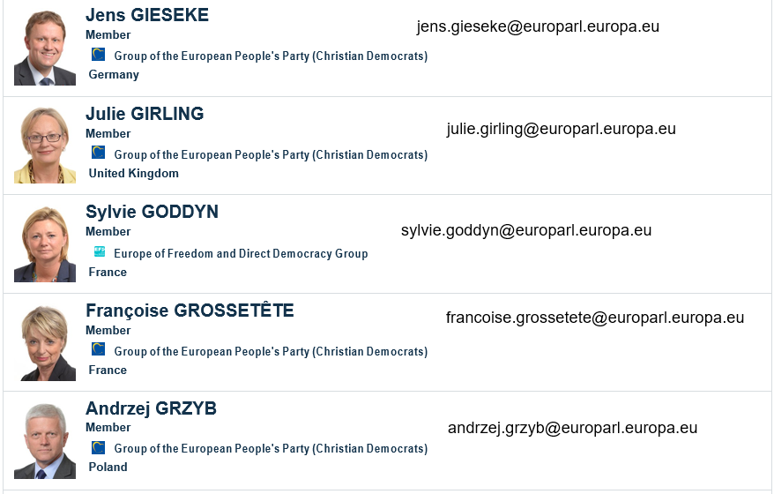

Slide 34
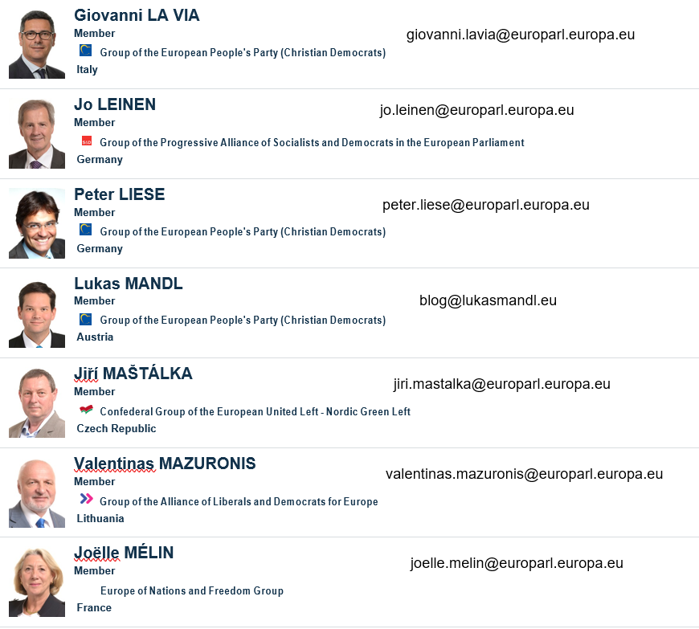
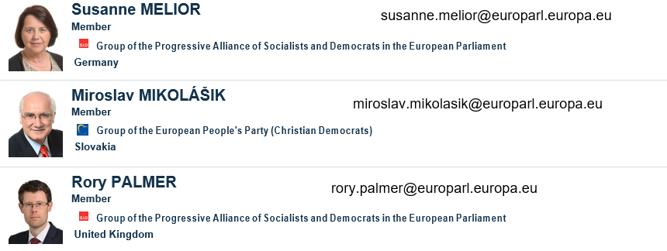
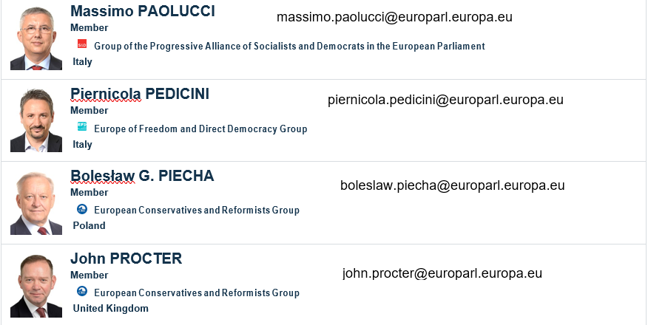

Slide 35
